Slide 1


Modeling a system
made by Vadim Boyko

Slide 2
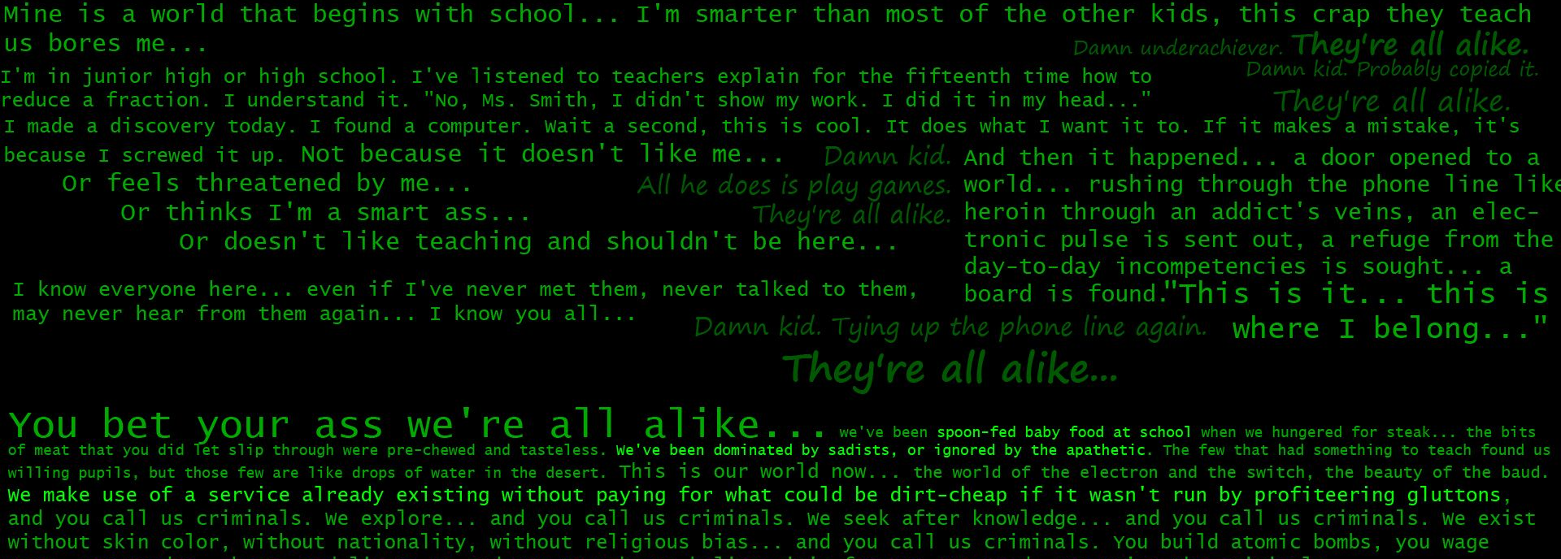
System modeling is the process of developing abstract models of a system, with each model presenting a different view or perspective of that system. It is about representing a system using some kind of graphical notation, which is now almost always based on notations in the Unified Modeling Language (UML).
Models help the analyst to understand the functionality of the system; they are used to communicate with customers.

Slide 3

Models can explain the system from different perspectives:
An external perspective, where you model the context or environment of the system.
An interaction perspective, where you model the interactions between a system and its environment, or between the components of a system.
A structural perspective, where you model the organization of a system or the structure of the data that is processed by the system.
A behavioral perspective, where you model the dynamic behavior of the system and how it responds to events.
Five types of UML diagrams that are the most useful for system modeling:
Activity diagrams, which show the activities involved in a process or in data processing.
Use case diagrams, which show the interactions between a system and its environment.
Sequence diagrams, which show interactions between actors and the system and between system components.
Class diagrams, which show the object classes in the system and the associations between these classes.
State diagrams, which show how the system reacts to internal and external events.

Slide 4

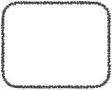
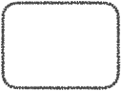

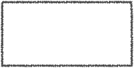
Context and process models
Context models are used to illustrate the operational context of a system - they show what lies outside the system boundaries. Social and organizational concerns may affect the decision on where to position system boundaries. Architectural models show the system and its relationship with other systems.
System boundaries are established to define what is inside and what is outside the system. They show other systems that are used or depend on the system being developed. The position of the system boundary has a profound effect on the system requirements. Defining a system boundary is a political judgment since there may be pressures to develop system boundaries that increase/decrease the influence or workload of different parts of an organization.
Context models simply show the other systems in the environment, not how the system being developed is used in that environment.
Process models reveal how the system being developed is used in broader business processes. UML activity diagrams may be used to define business process models.
The example below shows a UML activity diagram describing the process of involuntary detention and the role of MHC-PMS (mental healthcare patient management system) in it.
Transfer to
police station
Confirm
detention
decision
[not available]
find secure
place
inform
social care
[available]
[dangerous]
Transfer to
secure
hospital
Inform
patient of
rights
inform next
of kin
Record
detention
decision
Admit to
hospital
Update
register
[not
dangerous]
«system»
MHC-PMS
«system»
Admissions
system
«system»
MHC-PMS

Slide 5
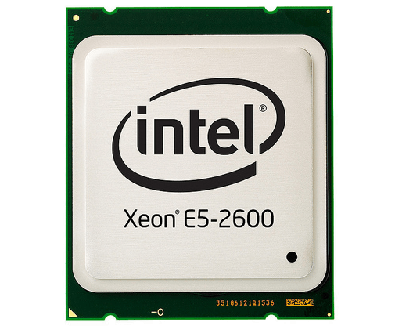

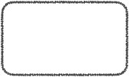

Interaction models
Types of interactions that can be represented in a model:
Modeling user interaction is important as it helps to identify user requirements.
Modeling system-to-system interaction highlights the communication problems that may arise.
Modeling component interaction helps us understand if a proposed system structure is likely to deliver the required system performance and dependability.
Use cases were developed originally to support requirements elicitation and now incorporated into the UML. Each use case represents a discrete task that involves external interaction with a system. Actors in a use case may be people or other systems. Use cases can be represented using a UML use case diagram and in a more detailed textual/tabular format.
Simple use case diagram:
Transfer
Data
Medical receptionist
Patient record system

Slide 6
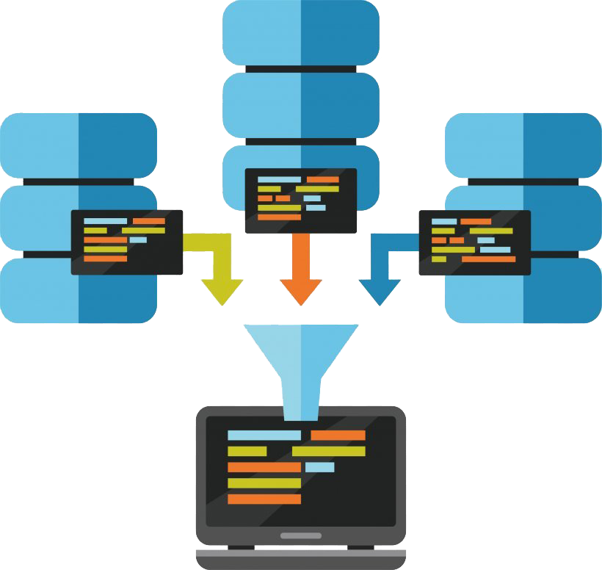
Structural models
Structural models of software display the organization of a system in terms of the components that make up that system and their relationships. Structural models may be static models, which show the structure of the system design, or dynamic models, which show the organization of the system when it is executing. You create structural models of a system when you are discussing and designing the system architecture.

Slide 7
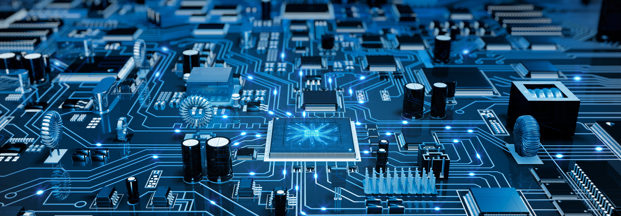
Generalization
Generalization is an everyday technique that we use to manage complexity. In modeling systems, it is often useful to examine the classes in a system to see if there is scope for generalization. In object-oriented languages, such as Java, generalization is implemented using the class inheritance mechanisms built into the language. In a generalization, the attributes and operations associated with higher-level classes are also associated with the lower-level classes. The lower-level classes are subclasses inherit the attributes and operations from their superclasses. These lower-level classes then add more specific attributes and operations.

Slide 8
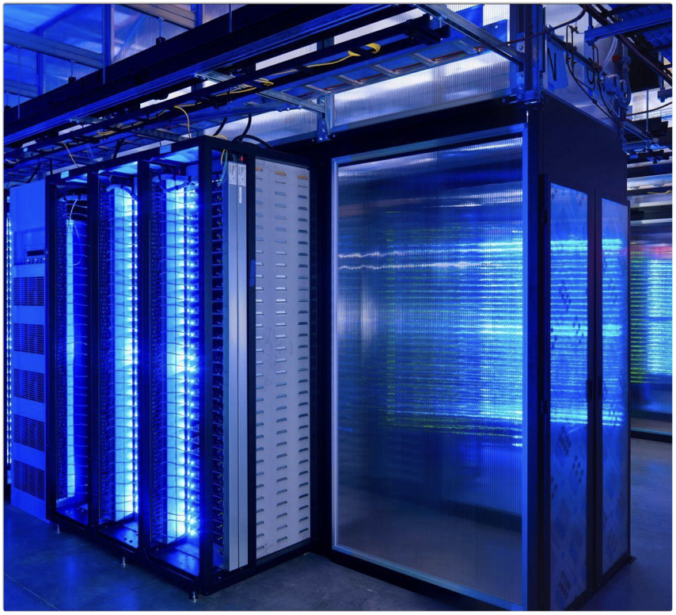
Behavioral models
Behavioral models are models of the dynamic behavior of a system as it is executing. They show what happens or what is supposed to happen when a system responds to a stimulus from its environment. Two types of stimuli:
1)Some data arrives that has to be processed by the system.
2)Some event happens that triggers system processing. Events may have associated data, although this is not always the case.
Many business systems are data-processing systems that are primarily driven by data. They are controlled by the data input to the system, with relatively little external event processing. Data-driven models show the sequence of actions involved in processing input data and generating an associated output. They are particularly useful during the analysis of requirements as they can be used to show end-to-end processing in a system.

Slide 9
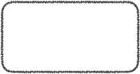


Real-time systems are often event-driven, with minimal data processing. For example, a landline phone switching system responds to events such as 'receiver off hook' by generating a dial tone. Event-driven models shows how a system responds to external and internal events. It is based on the assumption that a system has a finite number of states and that events (stimuli) may cause a transition from one state to another.
Event-driven models can be created using UML state diagrams:
Full
power
full power
do:set power
=600
Timer
Waiting
Full
power
Number
do:display
time
Set time
Operation
do:get number
exit:set time
do:operate
oven
Half
power
Door
closed
Cancel
Half
power
Start
Timer
Door
open
Half power
Enabled
Waiting
do:set power
=300
Door
opened
do:display
«Ready»
do:display
time
Door
closed
Disabled
do:display
«Waiting»

Slide 10
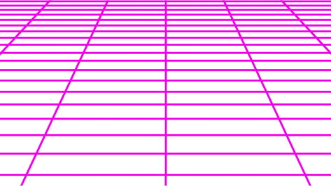
«Thank you for your attention»

